Slide 1
WALMART SALES DATA ANALYSIS

Slide 2
Aim of the project
To understand top performing branches and products.
To analyse the sales trend of different products and customer behaviour.
To examine ways to improve and for streamline sales strategies for optimization.
To identify the various factors affecting the sales performance across its different branches and over time.

Slide 3
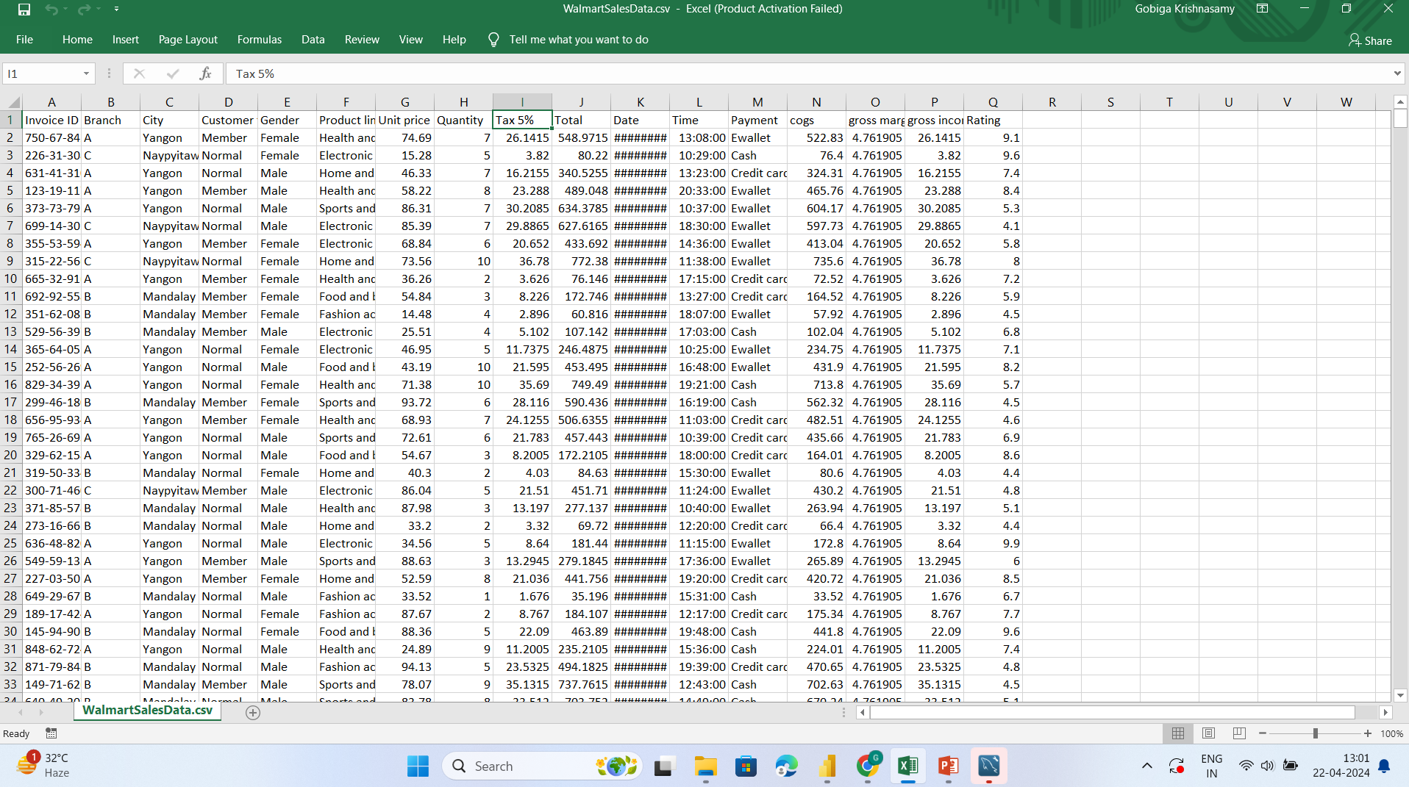
About the given dataset
The dataset comprises sales transactions from three distinct Walmart branches situated in Mandalay, Yangon and Naypyitaw respectively.
It consists of 17 columns and 1000 rows of data.
Stored in csv format.

Slide 4
Process of data analysis
Importing data from csv format into MYSQL database
Data cleaning (MYSQL)
Connecting MYSQL database with Power BI.
Creating interactive dashboard.
Create a database named salesdatawalmart.
Import a data and store the data in the form of table named sales.
Identify the null values and missing values and replace them.
Insert a 3 new columns into the sales table named time_of_day, day_name and month_name.

Slide 5
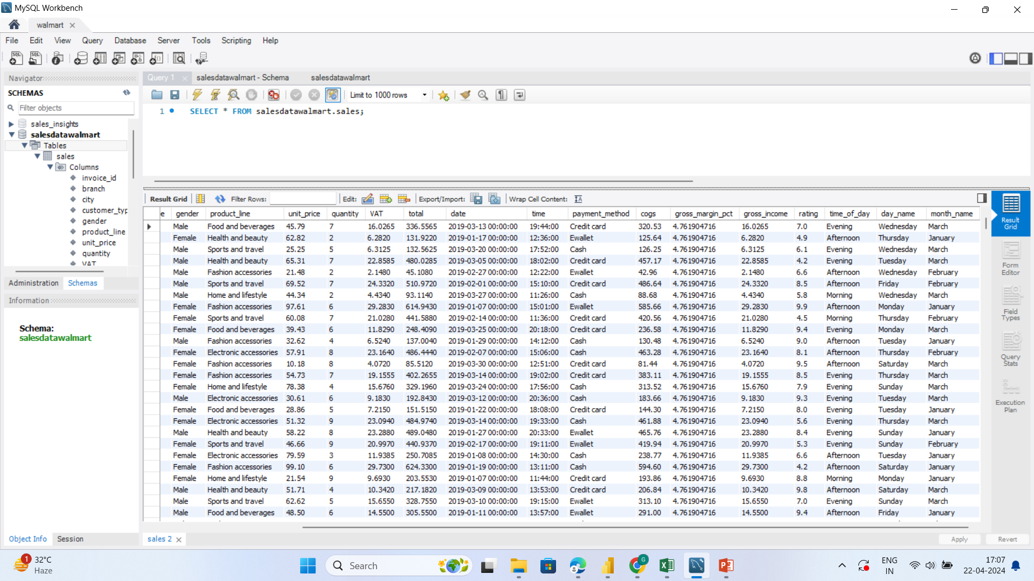

Slide 6
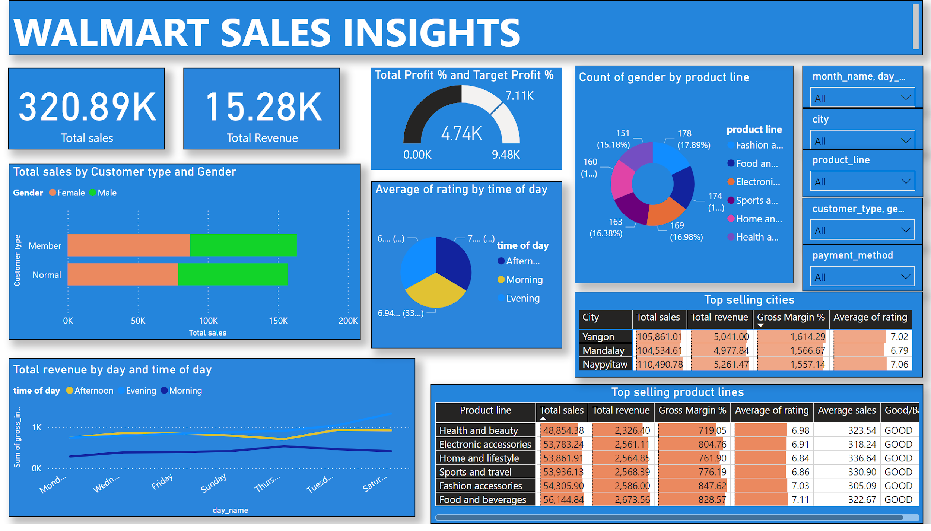
Notes:
Total revenue by day and time of day
No alt text provided
Count of gender by product line
No alt text provided
Top selling product lines
No alt text provided
barChart
No alt text provided
Average of rating by time of day
No alt text provided
textbox
No alt text provided
slicer
No alt text provided
slicer
No alt text provided
slicer
No alt text provided
slicer
No alt text provided
slicer
No alt text provided
card
No alt text provided
card
No alt text provided
Total Profit % and Target Profit %
No alt text provided
Top selling cities
No alt text provided

Slide 7
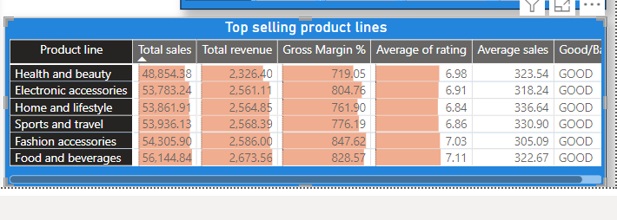
Business Inquiries
Based on the Product
What are the top selling product lines based on the total sales, total revenue, gross margin % and average of rating?
Whether the actual sales are greater than the average sales? (Good/Bad)

Slide 8
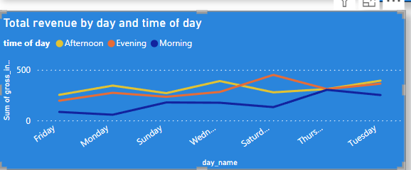
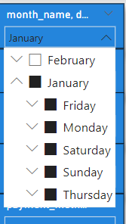
Business Inquiries
Based on the Product
How the revenue generated varying by month?
In which month, day and time of the day, the revenue gets affected?

Slide 9
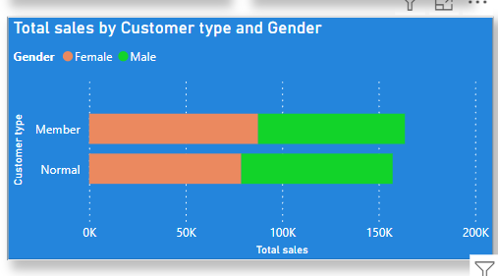
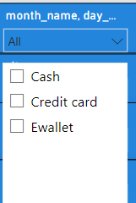
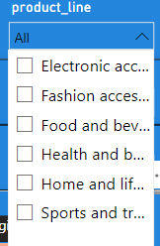
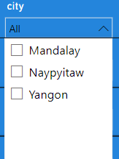
Business Inquiries
Based on the customer type and gender
Which type of customer is contributing more to sales?
Which gender is contributing more to sales?
What is the gender of most of the customers?
What is the gender distribution per branch?
What is the most common product line by gender?

Slide 10
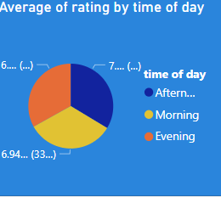
Business Inquiries
Based on the Product
In which time of the day, the rating will be more?
Which day of the week has the best avg ratings?
Which month has the best avg ratings?

Slide 11
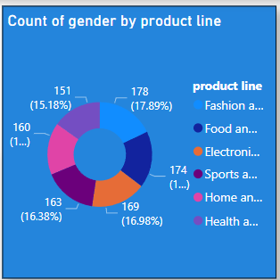
Business Inquiries
Based on the Product
Which product line is more attracted towards female/male?

Slide 12
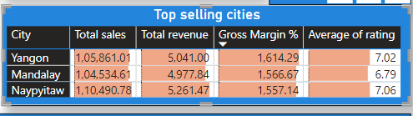
Business Inquiries
Based on the city and branch
What are the top selling cities based on the total sales, total revenue, gross margin % and average of rating?

Slide 13
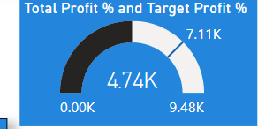
Business Inquiries
Based on the Product
Whether target profit % is achieved?

Slide 14
Factors affecting the sales
Weekdays/Weekends
Seasonal changes
Holidays, Festivals
Economical conditions
Technological changes

Slide 15
Thank you..!!

